Slide 1
Light handed Regulation and Work safety: a rail case study
Hazel Armstrong
NZ Fabian Society October 2012

Slide 2
Workers Memorial for those working for tranz Rail
In the five years 1995 to 2000 we remember those who died while working for Tranz Rail
Jack Neha
Thomas Blair
Murray Spence
Ronal Higgison
Bernie Drader
Paul Kyle
Nigel Cooper
Graham White
Ambrose Manaia
Neil Faithfull
And Robert Burt

Slide 3
A job for life or a life for a job? Robert Burt
May 2000
Caught under a train while shunting at the Middleton Freight depot
Stepped on a foot plate, slipped and fell under a moving wagon connected to a remote controlled locomotive

Slide 4
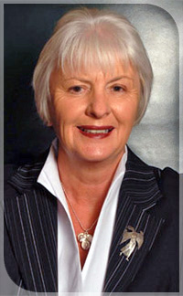
The Tranz Rail Inquiry 2000

Slide 5
Distancing rail from the state
The journey from 1974

Slide 6
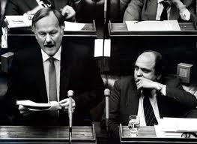
1974 Roger Douglas
A new direction for NZ Transport in 1974 hailed by Roger Douglas
Rail to forego protection from road haulage limits
I982 - removal of rail’s protection

Slide 7
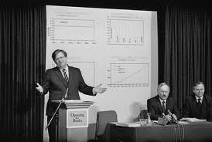
Richard Prebble Saving Rail
1984 election campaign
1984 – the Booz Allen Report proposes:
Eliminating guard vans
Reducing the size of crews
Reducing use of firemen
Increasing train size
Increasing week end operations

Slide 8
Staff Numbers reduce by 60% from 1983 to 1990

Slide 9
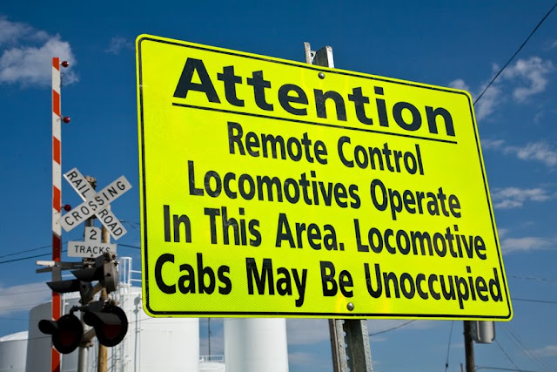
5 crew, then 3, then 2

Slide 10
Health and safety a tradable item

Slide 11
1993- 2003 a decade of exemption
Officials work with NZ Rail to gain exemption for rail employers from HSE Act
Rail employers exempted from new health and safety law from 1 April 1993
NZ Rail sold in 1993
The rail safety system was a mirage: it did not exist: it could not be viewed.

Slide 12
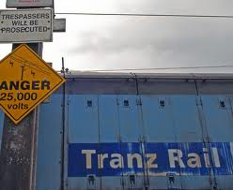
The sale of rail to the consortium
Rebranded in 1995 as Tranz Rail

Slide 13
The impact of deregulation on the safety of rail workers

Slide 14
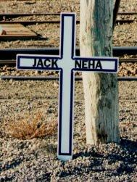
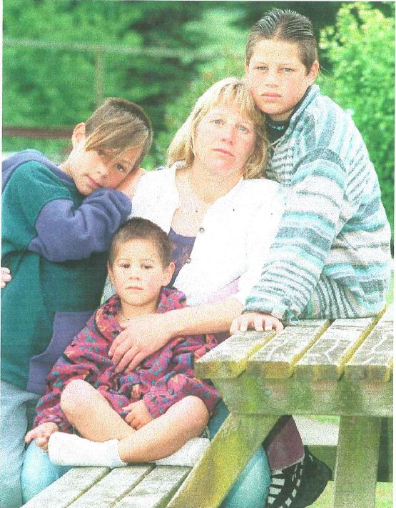
Jack Neha
In 1995, Jack Neha was killed in a shunting accident
He had had six weeks on the job training as a shunter
Manning levels reduced, he was on his own
“the wicket keeper removed”, the Judge said
He fell from a moving wagon, and was run over

Slide 15
Murray Spence
In 1996, Murray Spence died at age 35 years, he was a signals maintainer
He was cleaning and inspecting junction boxes when he was struck on the right side of his face by the corner of a southbound rail car

Slide 16
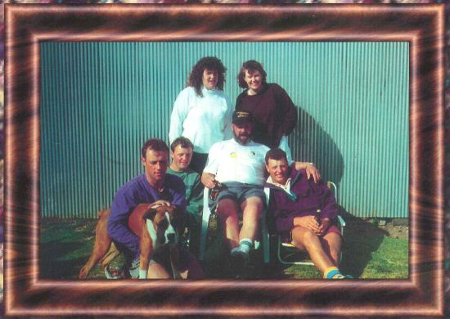
Neil Faithfull
In 2000, Neil Faithfull was killed when a wagon derailed and crushed him
He had five children
He had worked for Rail for 33 years
He was two years off retirement

Slide 17
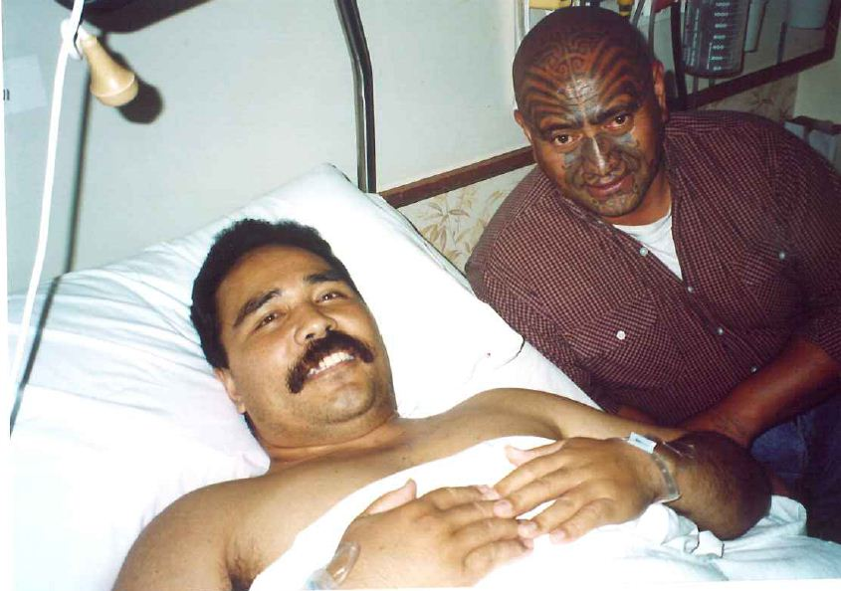
Injured at work: Ioasa Iuni
In 1998, Ioasa Iuni lost his leg in a shunting accident
The hand grip pulled away and he fell onto the track, the train ran over his leg
The hand grip had been inspected infrequently- 5 times in 6 years and was rusted and corroded
Non compliance with Mechanical code in approved safety system

Slide 18
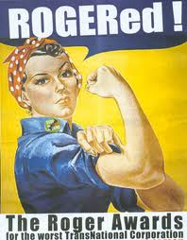
Tranz Rail wins again - 2000
A death rate 8 x the national average

Slide 19
After the inquiry
Rail brought back under the HSE Act
Health and safety improved with union involvement
New rules introduced
Reduction in injury rate – 40% reduction in lost time injuries and a 30% decrease in injury severity in first 12 months.

