Slide 1

Full funding, Experience rating and injury prevention
29th October
2012
Susan St John

Slide 2
Workshop
Susan St John
Felicity Lamm
Graham Rodgers

Slide 3
Woodhouse and safety
Prevention
Rehabilitation
Compensation
“The most important is obviously prevention”
“Effective education, adequate inspection and firm enforcement Must all be backed up by the allocation of funds”.
Notes:
Page one

Slide 4
Role of insurance model in ACC
Full funding required for solvency
Clearly defined and limited coverage
True competition required for privatisation of the work account and…..
Well on way to achieving full funding goal by 2019
No immediate plans for privatisation of the work account

Slide 5
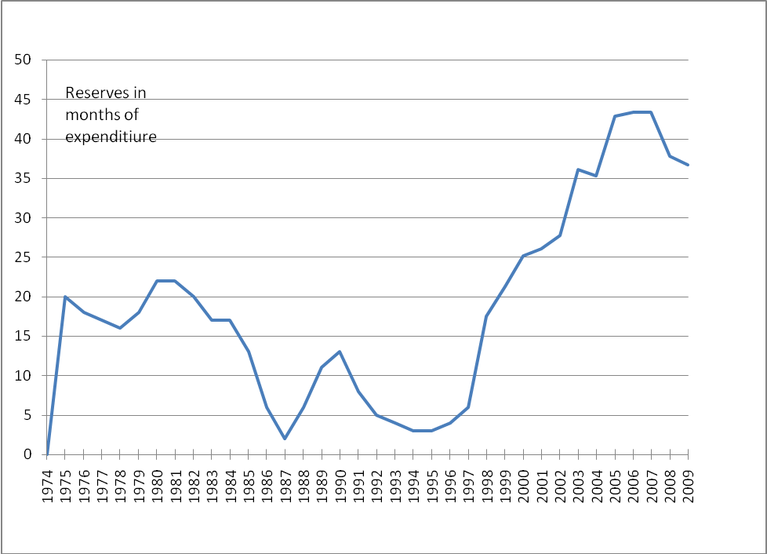
Reserves $21.7 billion Claims $2.6 billion
100 months

Slide 6
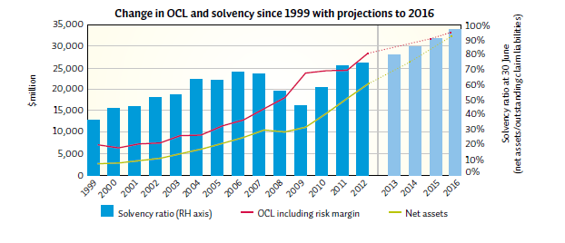

Slide 7
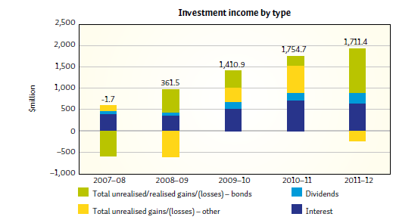
Annual report 2012
Impact of low interest rates:
Increase in outstanding claims liability
$3.8 billion
Higher investment income from bonds

Slide 8
ACC 2012 annual report
The organisation is now on a much better track financially, and the solvency of the Scheme has improved significantly. Positive investment returns, despite a difficult investment climate, coupled with a focus on effective rehabilitation, allowed the Government to reduce levies for the 2012–13 year.

Slide 9
Experience rating introduced 1 April 2011.
“It improves financial incentives for employers to encourage injury prevention in the workplace and help injured employees return to work as safely and quickly as possible”.
“employers who have lower than average injury rates, with better than average rehabilitation or return-to-work rates, may receive a discount on their ACC work levy. Those with worse than average claims experience may receive a loading on their levy.”
Experience-rated employers contribute 75% of the total levy income

Slide 10
But what are the costs of accidents- ie the MB of accident prevention?
“As per ACC’s legislative requirements, ACC can only spend money on injury prevention where it can be confident of delivering savings to the Scheme.” ( Statement of Intent ,2011-2014)
2009 ACC announced it would no longer fund the Otago Exercise Programme for preventing falls in the elderly. This was a hard decision to make as the programme was popular and had proven clinical benefit. However, the programme was not cost-effective to deliver and did not represent value-for-money.
What does ACC spend now?
Will it be as rigorous in assessing experience rating?
Notes:
2009 ACC announced it would no longer fund the Otago Exercise Programme for preventing falls in the elderly. This was a hard decision to make as the programme was popular and had proven clinical benefit. However, the programme was not cost-effective to deliver and did not represent value-for-money

Slide 11
Has experience rating worked?
What has happened?
What is the evaluation process?
Why no data?

