Slide 1

‘Choice’ in the Workplace account of ACC
Workshop presentation
‘ACC: A better future’ conference – October 2012

Slide 2
Why is Choice important?
For employers
Employers would cease to be price takers. Market theory suggests that competition between insurers will drive down costs
Employers might achieve greater influence over claims management.
For workers
?

Slide 3
Is ACC an insurer?
The purpose of ACC
“…is to deliver no-fault personal injury cover for everyone in New Zealand, including overseas visitors.
The Scheme supports the social contract where by individuals forego the right to sue for compensatory damages following an injury, in return for receiving personal injury cover.”
(ACC Statement of Intent)

Slide 4
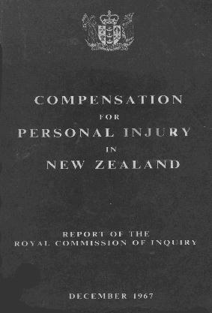
Is acc an insurer?
“As the scheme will be a government-scheme of social insurance it must in the final resort receive the backing of the state.” (Woodhouse, p 175)
“The change was done by substituting a single, state welfare service for the earlier systems; and converting the previous insurance premiums to taxes levied on wages and vehicles.” (Woodhouse to ACC Forum – The future of ACC, August 2011)

Slide 5
Is acc an insurer?
ACC is just private insurance run by the state  Coverage limited Tight demarcation  Actuarial funding Differential levies Experience rating to drive safety Privatisation Narrow insurance scheme | ACC is social insurance  Entitlements in statute (No fine print) Coverage can expand Flexible for new risks PAYG principle Flat-rate levies Risk pooling Safety separate issue

Slide 6
The experience of 1999
Increase in the number of disputed claims for cover, often between the private insurers themselves.
More applications for review were generated.
Culture of non- or under-reporting of workplace accidents
Additional administrative burdens for all treatment provider types
Private insurers were reluctant to approve claims and were often late in honouring invoices
Claimants knew little about their entitlements, including the identity of the workplace insurer
HIH failure

Slide 7
The 2011 proposals
Employers able to choose work-related personal injury cover from private insurer or ACC
ACC to remain in the market as a Crown Agent (no tax, no return to government)
Choice on ‘opt-out’ basis (ACC as default provider)
ACC’s pricing for Work Account cover to be deregulated
Central claims handling facility
ACC to take over cost of claims management in event of insurer insolvency – funded by levy on all insurers
Levy on insurers for public health acute services

Slide 8
Problems with 2011 proposals
Limited margin to lower costs (ACC administratively efficient, falling levies, AEP and experience rating options)
ACC with competitive advantage
Lack of evidence of employer demand
Lack of interest from insurers
Unknown costs of regulatory regime
Unknown how residual claims will be funded
Unknown how costs of gradual process injuries will be allocated
Unknown how the costs of public health and emergency transport services will be allocated

Slide 9
Official advice
“there is a high degree of uncertainty regarding the magnitude of both costs and benefits (and in some cases, even the sign – i.e. whether they will have a net positive or negative impact…”
… “better pricing signals to employers can be achieved through experience rating and self-insurance arrangements”.

Slide 10
If not choice then what?
Improving control through better engagement with ACC?

