Slide 1
Rehabilitation,
Vocational Independence and Independent Assessors
Preliminary results of Acclaim Otago’s online survey
And
Prospective Outcomes of Injury Study
Dr Denise Powell and Dr Sarah Derrett
ACC : A Better Future
29th October 2012

Slide 2

The Survey
Completed by 713 people between July-October 2012
91% were either current or previous clients of ACC
‘Other’ category included carers, family
members, and treatment providers

Slide 3
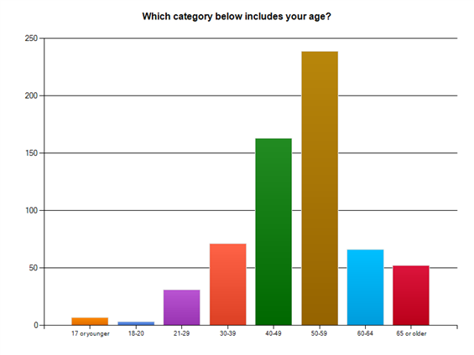
Demographics
Notes:
51% male 49% female

Slide 4
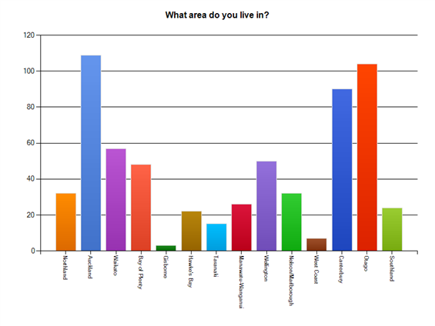

Slide 5
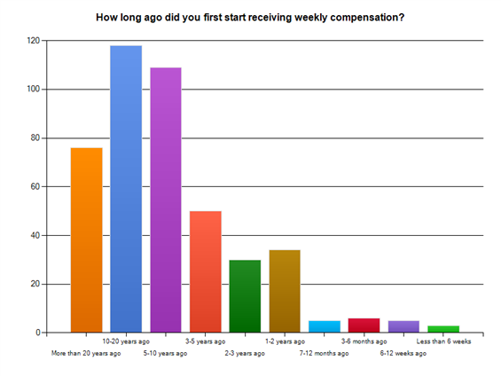

Slide 6
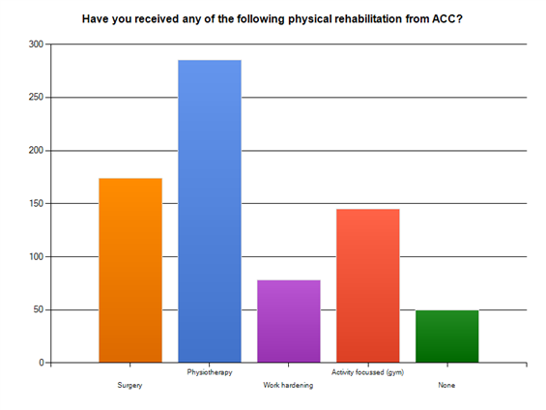
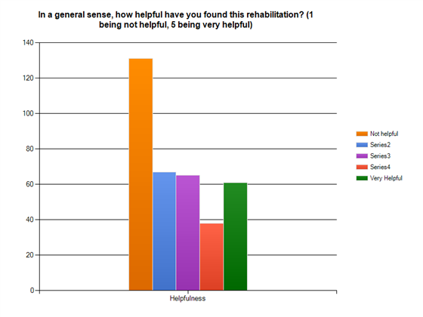
Physical Rehabilitation

Slide 7
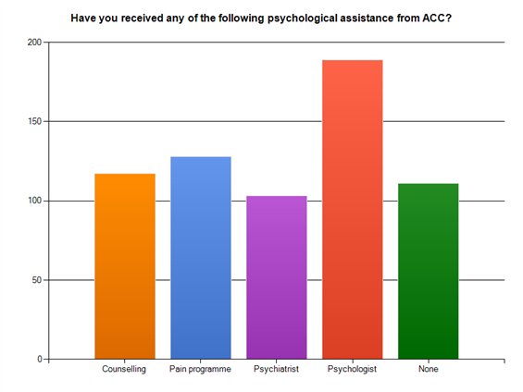
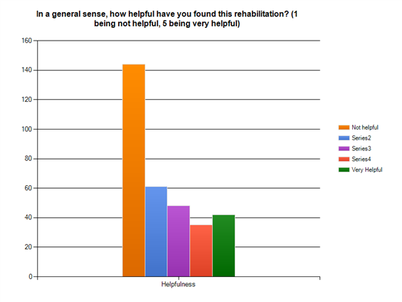
Psychological Rehabilitation

Slide 8
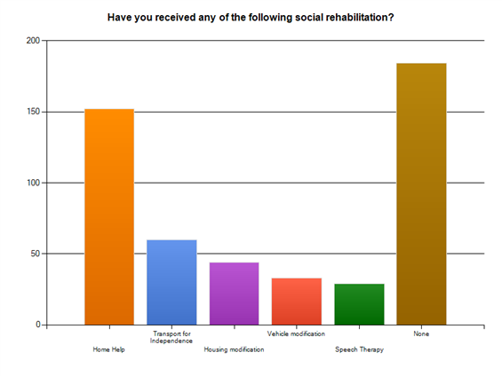
Social Rehabilitation

Slide 9
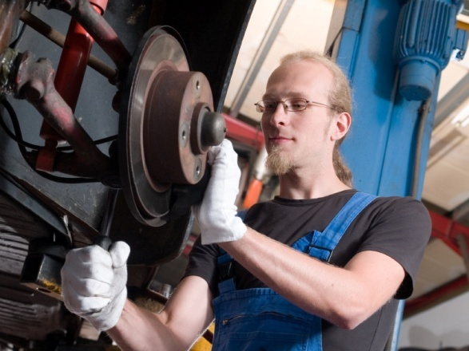
Vocational Rehabilitation:
Work trials
    Most clients (80%) who undertook a
    work trial worked less than 20 hours
    a week on the trial.
    45% were less than 10 hours a week, and 35% were between 10-20hrs a week
    77% said they felt pressured to do more than they could by ACC and reported that the work trial made their injury worse.

Slide 10

“They caused my neck and shoulder injury when they sent me to a work preparation course and I ended up with 4 prolapsed discs and torn rotator cuff which resulted in two further operations.”

Slide 11

Courses
42% of the training courses people received were less than 6 weeks in duration.
Another 18% were for less than 3 months in total.
Just under half of the people who had undertaken a course felt they were ‘not at all helpful’.

Slide 12

“1 day retail course, and about to do a 1 hour computer course”
“Evening computer course 2 hrs per week”
“NZ Diploma in Business”
“Basic Microsoft Office”
“Computer, marketing & keeping a 7 day diary of activities from 7.30am- 6.30pm (very intrusive !)”

Slide 13
Return to work programmes
  40% of those who undertook a return to work programme did return to work
  However……….
  only 10% of those felt they were able to maintain the job ‘completely’,
  35% were able to maintain the job ‘somewhat’
  and 55% said they were able to maintain the job ‘not very well’ or ‘not at all’.

Slide 14

“I felt that there was pressure from ACC to return to work. I was asked to go to work place assessments to review what work I was suitable for based on my previous experience. Dr said I was suited to working as a fruit and nut picker despite experiencing fatigue. I felt they tried to rush me…. I did eventually get a job but more so because I knew the manager previously and my employer was willing to accommodate my many bouts of errors and confusion.”
“The drugs I take have warnings that I may become drowsy & should not operate machinery but my case manager told me that ACC would verify I was on medication, if I was tested drug positive by a traffic officer”. (Truck driver)

Slide 15

What were the main reasons for exit?
Vocational Independence process
File reviews
Non-compliance

Slide 16
Independent Assessors?
High number of repeated assessments
50% of the respondents had more than 10 assessments and 10% of the total sample had 30+ assessments
Uncommon frequency in the use of certain assessors with high exit rates – (their conclusions being cited as the reason for exit from ACC)
Dr A – 38% Dr B - 37%
Dr C – 36% Dr D – 30%
Notes:
just under 50% had had more than 10 assessments and 10% of the total sample had 30+ assessments.

Slide 17

Choice of Assessor
People assessed by these four doctors were given less choice of who the assessor was to be:
Dr A – 96% had no choice
Dr B – 87% had no choice
Dr C – 83% had no choice
Dr D–100% had no choice
Notes:
Average choice of assessor across all assessments
20% had a choice, 80% had no choice of assessor

Slide 18
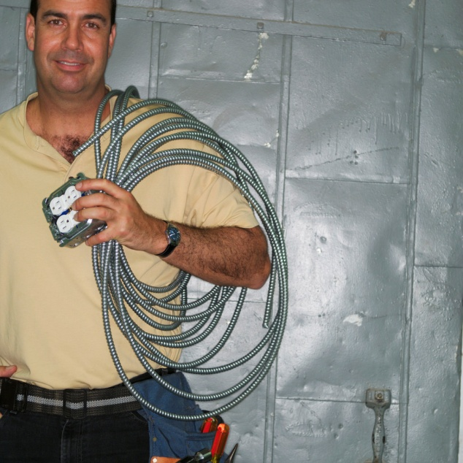

“In his medical report he said that the wound had healed up & that I could work as a TAB operator, a job in which I have no previous experience in, nor was I offered any training by ACC to do the job. I am in fact an electrician by trade!”

Slide 19

File reviews
Mostly long term clients with
claims lasting more than 5 years.
Clients’ files were reviewed by an assessor often without any input from the person, their employer or their treatment providers.
Most were subsequently exited from ACC

Slide 20
So what has happened to these people?
  25% of people who lost their entitlement to weekly compensation were working, at least in some capacity.
  However, of those -
  75% were working less than 30 hours per week (the current threshold for Vocational Independence)

Slide 21
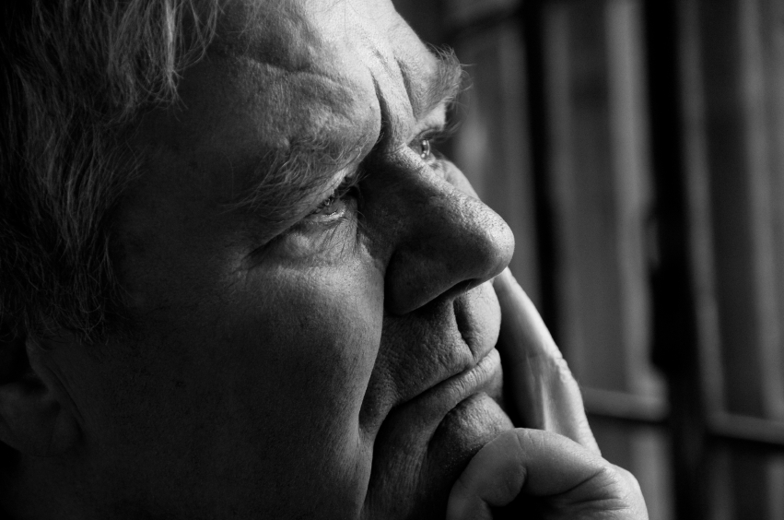
        Over 75% of people who had lost entitlement to weekly compensation were not working at the time of the survey.
  Half of these people were not entitled to WINZ payments for reasons such as their partner was working and therefore do not show up on the data kept by Ministry of Social Development about reasons for claiming a WINZ benefit ( ie ACC compensation ceased).

Slide 22
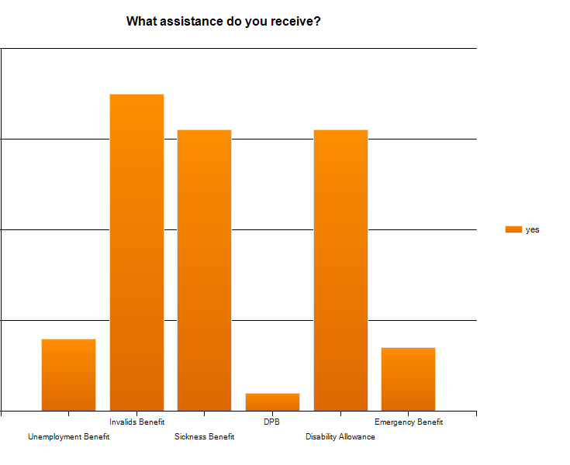
  The other half of these people received WINZ assistance.
  Most of them however, don’t receive the unemployment benefit because they were certified by a designated doctor as either:
  Unable to work (Invalids benefit) or,
  Having limited capacity to work (Sickness benefit)

Slide 23
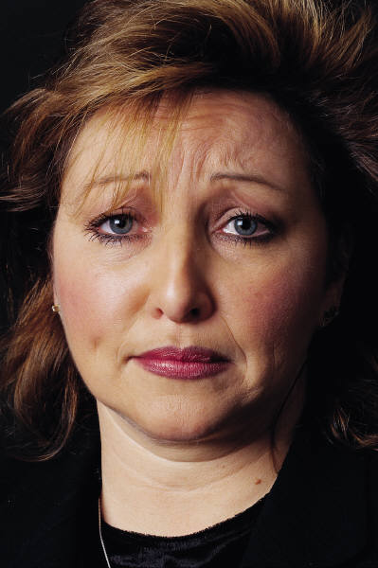
“ACC also do a great job acting as a gate keeper for the amount of people receiving entitlements and essentially act as a conveyor belt for long-term claimants who are unable to work, to the front door of their local WINZ office”
“I still suffer majorly from my injury,
still can not work and all they did is get
me off ACC and onto WINZ Sickness
benefit”

Slide 24
ACC Data
“Return to work”
Measures the proportion of workers who are in employment at the point they stop receiving support from the Scheme.
“Durable return to work”
Measures the proportion of workers who are in employment at the time the survey is conducted
These ACC statistics do not identify what happens to long term injured clients after they stop receiving ACC weekly compensation.
Notes:
As we have said previously, ACC does not currently keep data that identifies what happens once a long-term client exits the scheme. ACC do use the Australia and New Zealand Return to Work Monitor, which surveys a sample of workers in both countries who suffer an injury at work, and had 10 days or more compensation paid. This survey compares the success of both countries workers compensation scheme in terms of:

Slide 25
Prospective Outcomes of Injury Study
(POIS)
Injury Prevention Research Unit, Dunedin School of Medicine, University of Otago
Funded by the Health Research Council (2007-2013) with co-funding from ACC (2007-2010)
Little understanding of outcomes for people after injury
Aim: To identify factors associated with outcomes for injured New Zealanders

Slide 26
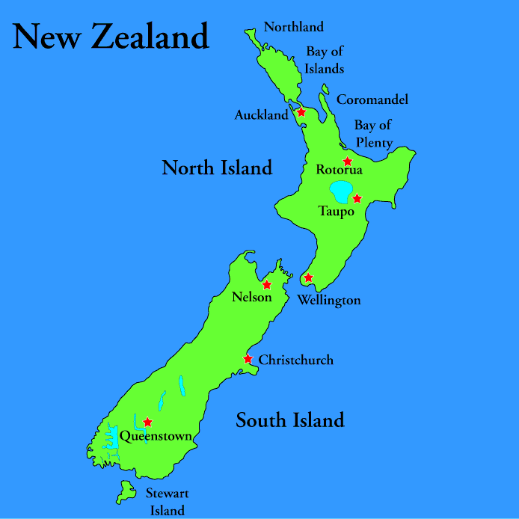
What we did:
2856 New Zealanders (18-64 years)
20% Māori participants (n=566)
Via entitlement claims register
Over 24 months; 4 interviews
Snapshot of provisional results

Slide 27

What we found: Work after injury
Of 2626 people in paid employment before their injury:
3 months after injury: 73% were back at work
  Of those not back at work – the majority (71%) anticipate recovery to usual work
12 months after injury: 84% were back at work

Slide 28


What affected return to work?
Not associated with return to work 3-months after injury:
Age, sex, chronic conditions, general health, psychosocial factors (depression, optimism, self-efficacy)
Associated with return to work 3-months after injury :
Low income, financial insecurity ,obesity, blue collar occupations, painful/tiring work, standing at work, temporary contracts & long work week

Slide 29
Rehabilitation/Back at work
People with an injury are much more likely to be back at work 12 months later compared to those with stroke
Suggests ACC support is effective in returning people to work
Durability of return to work

Slide 30
Rehabilitation and support
“Obviously they are there to help and provide income, have done that, have provided taxis – but it seems to be more based around getting you to be back to work than getting your injury fixed”
“They’ve been upfront about everything, very cooperative, have listened to me – always very approachable. The case worker is very good at getting back to me – gets back within the hour. Also very good at liaising with my employer”

Slide 31
Draft ACC Futures Manifesto
The primary focus of ACC should be on the claimant, while recognising the need for the scheme to be sustainable. The ‘Woodhouse principles’ of community responsibility, comprehensive entitlement, complete rehabilitation, real compensation and administrative efficiency remain as valid today as when first propounded in the 1960s.
That ACC adopt outcome based goals that reflect meaningful results, such as a sustainable return to work, instead of targets based on narrow outputs, such as reducing the number of claimants on weekly compensation. Remuneration systems that reward such perverse incentives should be reviewed.

Slide 32
When New Zealanders gave up the right to sue for personal injury we also gave up the right to compensation for loss of potential earnings.
In return we had a scheme that was focused on rehabilitation as well as compensation, but vocational independence testing has developed as a punitive tool to drive people off the scheme, either onto benefits or into jobs that are not comparable with the income they have lost.
The standards for determining that a person is vocationally independent are set too low and it is being used too early and frequently in the claimant’s rehabilitation.

Slide 33
ACC Futures Coalition recognises the value of work and meaningful occupation and wants a focus on rehabilitation (including retraining) that enables claimants to achieve that.
Vocational independence testing either needs to be abandoned or be based on objective evidence that the injured person can return to work at the same occupation or one that enables them to engage in work that provides appropriate rewards and is meaningful to them.

Slide 34
Independent assessors
The ACC Futures Coalition supports the establishment of a panel of medical specialists, under the aegis of the Health and Disability Commissioner, for the purpose of ensuring the independence of ACC commissioned medical assessments and vocational independence assessments.
Claimants should have the right to select an appropriately qualified assessor of their choice from among those approved by the panel.
No ACC commissioned specialist should be engaged by ACC for more than 40% of their time in order to avoid the perception of a conflict of interest.

Slide 35
What should the ACC Futures Manifesto be saying about:
Rehabilitation?
Vocational Independence?
Independent Assessors?

