Slide 1
Occupational Disease in New Zealand: reducing the disparity between estimated incidence and ACC claims
Hazel Armstrong and Ben Thompson
Hazel Armstrong Law

Slide 2
Overview
Research suggests a high incidence of occupational disease (‘OD’) in New Zealand.
Our no-fault compensation scheme covers OD; however there is a significant disparity between the incidence of OD and the number of claims lodged with ACC.

Slide 3
Occupational Disease v Occupational Injury
OD defined by the ILO as a ‘disease contracted as a result of exposure over a period of time to risk factors arising from work activity’.
Distinct to workplace injuries – discrete events with immediate effects.

Slide 4
Occupational Disease in New Zealand
High incidence of OD in New Zealand.
NOHSAC estimates 17,000 – 20,000 new OD cases arise annually.
2,500 – 5,500 classified as ‘severe’ – i.e. requiring payment of weekly compensation.
NIOSH’s figures have recently been accepted by MOBIE – see publication ‘The State of Workplace Health and Safety in New Zealand’, September 2012

Slide 5
Occupational Disease in New Zealand
NOHSAC estimates 700 – 1,000 deaths from OD annually. 30-40% are cancers.
More than 80% of work-related deaths (most due to disease) are not documented, reported or investigated.
In 2004-2005, there were an estimated 18,500 OD incidents, attracting a financial cost of NZ$1.1 billion.

Slide 6
Occupational Disease and ACC
OD is covered by the ACC scheme – ‘work-related gradual process, disease or infection’.
2 routes to cover:
Fulfilment of the 3-part test under section 30 of the Accident Compensation Act; or
Proving that the OD is one listed in Schedule 2 of the AC Act.

Slide 7
Occupational Disease and ACC
The 3-part test requires a claimant to prove:
A property or characteristic in the workplace caused or contributed to the personal injury;
That property or characteristic is not found to any material extent in the claimant’s non-employment activities or environment; and
The risk of injury is significantly greater for persons performing that task in that environment.

Slide 8
Occupational Disease and ACC
Section 60 of the AC Act: cover presumed for conditions resulting from exposure to certain substances known to cause OD.
These conditions are listed in Schedule 2 (41 conditions).
ACC can only deny cover if it can establish a non-work cause.

Slide 9
Occupational Disease and ACC
Statistics show ACC coverage of OD is low.
From the 17,000 – 20,000 average annual new OD incidents, only 1,035 claims are lodged with ACC and only 554 are accepted (on average).
From the estimated 700 – 1,000 deaths arising from OD each year, only 10 ACC claims involve the death of the claimant (on average).

Slide 10
Occupational Disease and ACC
ACC data does not reflect the incidence of OD.
The test for cover can be difficult, but even the number of claims lodged is disproportionately low.
Statistics show that a lot of people suffering from OD are not receiving entitlements.
Cost of OD therefore falling on the workers and their families.

Slide 11
What are the problems?
Not enough claims getting lodged.
Lack of information regarding exposures in individual cases.

Slide 12
Getting claims lodged
In the context of OD, most likely that the worker will first visit his or her GP in relation to symptoms. Then will visit DHB, if symptoms deteriorate.
GPs and DHB staff need to recognise the possibility of an occupational cause.
Low number of approaches to ACC suggests that GPs and DHB staff are failing to recognise cases of OD.

Slide 13
Getting claims lodged
Further education of GPs and DHB staff may be required.
In July 2007 ACC issued fact sheets on occupational causes of:
Certain types of cancers;
Dermatitis;
Asthma and Chronic Obstructive Pulmonary Disease.
We understand that some OD training also takes place at the trainee level.

Slide 14
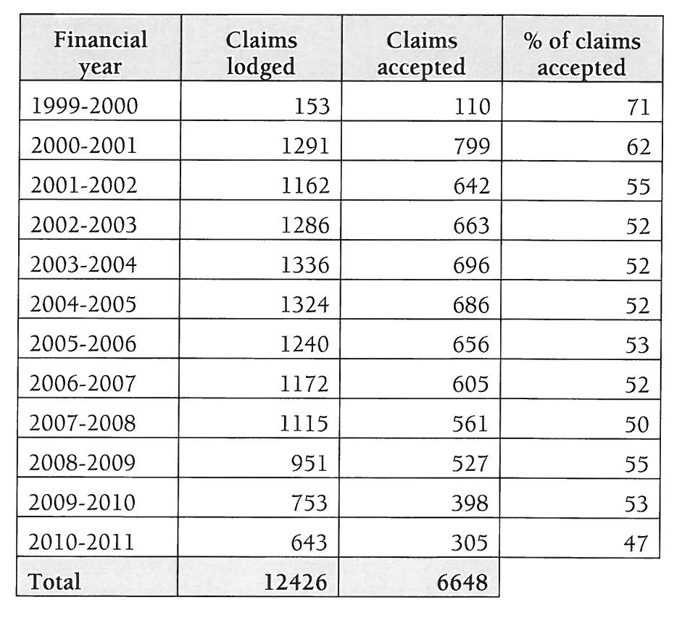
Getting claims lodged
However, the numbers of claims lodged, and numbers of claims accepted, have steadily dropped since 2004:

Slide 15
Getting claims lodged
Nothing to suggest that the incidence of OD has dropped.
We suggest that further work needs to be done to ensure that GPs recognise potential cases of OD.
Without this recognition, claim numbers will remain low and the problem will go unaddressed.

Slide 16
Determining workplace exposure
Distinct but related to the issue of recognising potential cases of OD.
Lack of objective, contemporaneous evidence regarding the nature and extent of exposure to causative agents in NZ workplaces.
Employers failing in their duty to carry out monitoring of exposures.

Slide 17
Determining workplace expsoure
This failure undermines the ability to accurately diagnose cases of OD, which in turn undermines the chances of the worker receiving ACC cover.
In many cases, the onus is on the employee to positively prove causation – how can this be done, without solid evidence of exposure?

Slide 18
Duty to monitor: Health and Safety in Employment Act 1992
General duty to take all practicable steps to ensure safety of employees: s 6. At least arguable that this would include surveillance and/or monitoring.
If a ‘significant hazard’ cannot be eliminated or isolated, all practicable steps must be taken to minimise the chance of that hazard causing harm (ss 7 – 10).

Slide 19
Duty to monitor: Health and Safety in Employment Act 1992
In the context of minimising the risk posed by significant hazards, section 10 requires employers to:
Monitor workers' exposure to the hazard;
With workers’ consent, monitor their health in relation to the particular hazard.

Slide 20
Duty to monitor: Health and Safety in Employment Act 1992
In our experience, compliance with this duty is minimal.
Leads to serious difficulties in gauging an individual worker’s historical exposure.
Arguably, lax attitude to monitoring is a result of the absence of the threat of civil personal injury proceedings, along with a failure to enforce the duty to monitor by way of prosecutions brought under the HSE Act.

Slide 21
Estimating historical exposures
Ensuring monitoring of worker exposure and health is essential, but will not assist in cases of historical exposure.
In such cases, steps must be taken to ensure the worker’s exposure is accurately estimated.
Simply relying on the worker’s own recall is insufficient.

Slide 22
Estimating historical exposures
Careful history taking. Assistance should be given to ACC claimants when filling out claim forms.
Reference to medical research on exposure levels by industry (both in New Zealand and abroad).
Construction of a NZ ‘Job Exposure Matrix’.

Slide 23
Advisory Committee
To assist in implementing these steps, a Gradual Process Advisory Committee should be established to carry out research and provide advice to ACC.
Such a Committee existed previously, but was disbanded by the current National Government.
Committee should comprise of occupational physicians, academics specialising in incidence of OD, lawyers, union and employer representatives.

Slide 24
Specific focus: Schedule 2
We also suggest that the focus (at least initially) be on certain conditions within Schedule 2.
The hard work on causation has been done – inclusion into the Schedule is dependant upon an occupational link.
Shifts the legal burden off the worker – to decline cover, ACC must prove that there is a non-workplace cause.

Slide 25
Why ACC’s responsibility?
Under the Accident Compensation Act, a ‘primary function’ is the ‘promotion of measures to reduce the incidence and severity of personal injury’.
The need for preventative measures is established by, amongst other things, reference to claims data.
Artificially low claim numbers will be a barrier to injury prevention measures.

Slide 26
Implications for ACC’s liability
Obviously, an increase in OD will see an increase in ACC’s fiscal liability.
This is to be encouraged; the status quo does not represent the true liability.
We suggest that the cost of OD claims would most fairly and effectively be funded by a flat-rate levy shared amongst all employers.

Slide 27
Conclusion
Large disparity between the incidence of OD and the number of claims being made to ACC.
This necessarily results in the cost of OD being borne by workers and their families.
Given it’s primary function of injury prevention, there is a duty on ACC to play a lead role in educating GPs and gathering accurate workplace exposure data.

Slide 28
ACC Futures Manifesto
Statement regarding OD:
Occupational disease usually involves long-latency and multiple employers, and in some cases (such as hearing loss) it can be difficult to establish the extent to which the problem was work related, degenerative or arose as a consequence of activity outside of work. We support a review of occupational disease management (including hearing loss) with a view to removing the barriers to treatment and improving the co-ordination of the funding with the health system, DHB’s and ACC.

