Slide 1
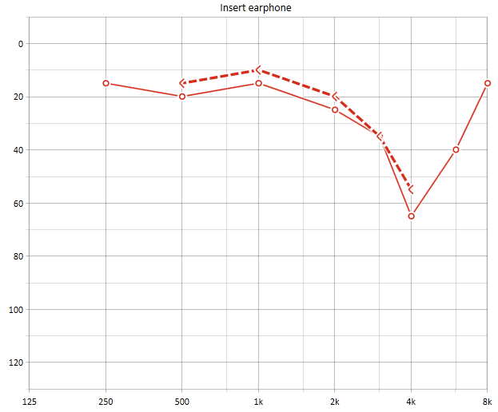
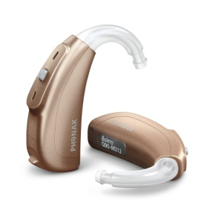
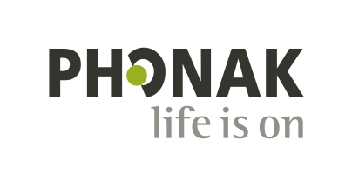
Changes in ACC cover for Hearing Loss Occupational Noise Induced Hearing Loss (ONIHL)
Mike Sharp
Phonak NZ Ltd

Slide 2
A note on the quality of available information
Data presented today obtained from a variety of sources
ACC
Industry sources (e.g. HIMADA)
OIA requests
Direct comparison of various data sets not always possible
Historical data may not be complete wrt recent
Differences in what various data sets actually representing
=>Trends are indicative, but not always absolute

Slide 3
ACC & ONIHL: pre 2008
All costs of treating diagnosed & liable ONIHL covered by ACC
Contract with service providers from 2001, no contract with hearing aid manufacturers
Effectively a doubling in demand for ACC hearing loss services between 2000 & 2007
Period of growth in audiology profession (number of audiologists & clinics) & significant technological developments
Contributed to increased demand for hearing loss services in general, and also including ACC
Notes:
To explain the current status of ONIHL management by ACC it is worth looking at history and the efforts that have been made by ACC and the audiology profession to achieve the a good balance of access to quality & meaningful service and effective cost management
Maybe a chicken and egg sitn re demand growth – more services & more opportunity for services, but also coincided with lift in hearing aid tech & therefore what outcomes can be achieved and the impact of ~10 year sof Akld aud program in terms of audiologists (i.e. service under-delivered before then)

Slide 4
ACC & ONIHL: 2008-2010 Industry Accord & Contracting for Service
Strategy to manage growing demand and cost
Tri-party accord between audiology providers, the manufacturers & ACC
Tools:
Hearing needs assessment to formally identify the most cost-effective hearing aids for claimant (peer reviewed)
Performance based contracts for audiology providers, including average hearing aid cost & client satisfaction targets
Contracts with manufacturers including discounts for ACC to ‘encourage’ average price target attainment
Notes:
Growth in demand required a new strategy to manage costs
Accord was very successful balance in terms of delivery good outcomes to claimaints and more effective management of costs

Slide 5
ACC & ONIHL: 2008-2010 What did the Accord achieve?
Significant reduction in average cost of hearing aids
From $2,300 to $1,729 -25%
Needs assessment & average price target lowered average technology level prescribed
Further enhanced by manufacturer discounts to ACC
No impact in access to aids, or replacement timing
~7mio in savings per annum
ACC Board Paper 2006: anticipated 85mio spend in 2009/10 (before Accord)
Actual spend 2009/10: ~65mio
Increase in the average age for re-aiding
From ~4.6 years in 2005 to 6.2 years in 2009
Notes:
In realtively short time good cost savings were achieved without a significant compromise to access and quality of service provision
Make note that effective rehab not just about the technology, audiological services also a big part of it
Increase in reaiding probably a combination better technology (;ess need) and ACCs efforts to repair where at all possible (even on old or inappropriate tech)

Slide 6
ACC & ONIHL: July 2010 Introduction of minimum threshold for injury
Minimum threshold for injury of 6% hearing loss introduced
Intended to eliminate situation where claimant eligible for cover but where not eligible for entitlement (rehabilitation)
Key point #1: 6% threshold for ONIHL only
Effects of aging (average) & other hearing loss backed out from %
A key point: 6% hearing loss ≠ a hearing disability of just 6%
Damage from noise typically centred in same areas of hearing used for processing speech
A 6% hearing loss in the higher frequencies of hearing can result in low levels of speech understanding when competing sound is present
Notes:
In theory an administrative procedure that drive some cost saving.
ENTs are asked to determine EXACT percentage of noise related h-loss.
Claimants are being asked to give a full history of their noise exposure which raises issues of recollecection and communicating an accurate impression of the exposure (?cultural issues)
Hard for them to give accurate histories from situations occurring 40 years ago. Proximity of themselves to the airgun when it went off, how many times a day it was used etc.
LOTS OF ASSUMPTIONS MADE – ORLs often diagnosis percentages to the claimants h-loss as “idiopathic” or unknown hearing loss. Difficult for ENT to accurately (down to a percentage amount) say how much of a persons’ hearing loss was due to noise – particularly when faced with lack of serial audiograms and poor histories.
Describe sitn of 49 yo and 75 yo with same audiogram could mean 1 entitled to cover, 1 not because of average impact of age
Explain what impact of 6% hearing loss could be like, if no correction for age or other ideopathic loss is a significant occupational injury

Slide 7
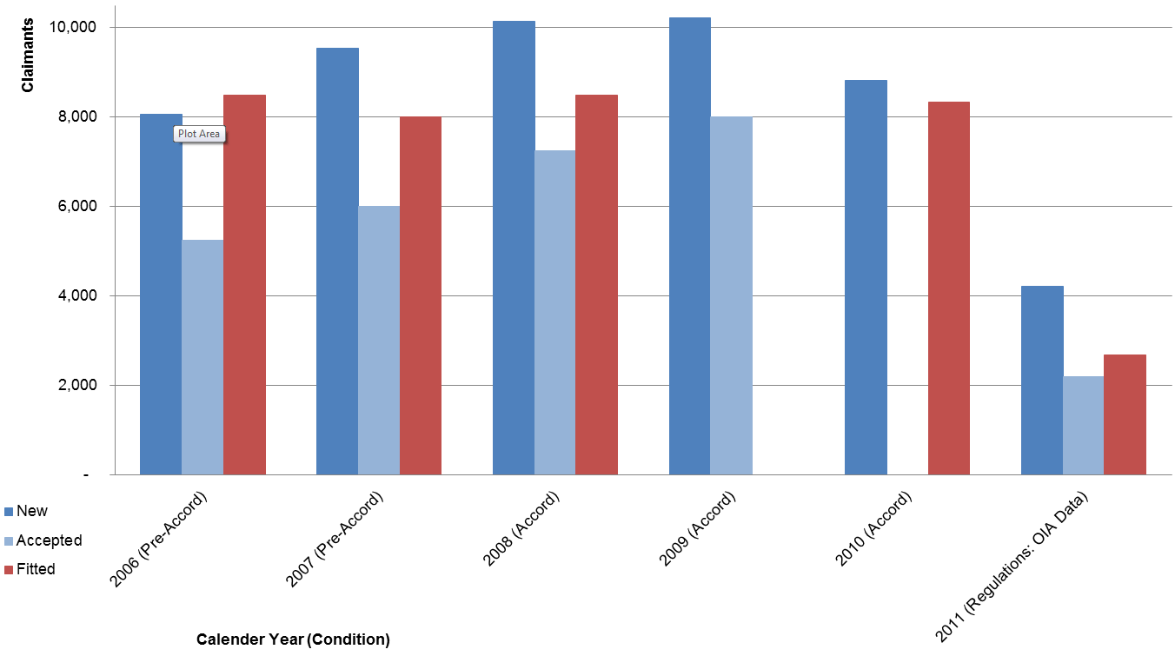
How things looked pre-regulations Demand for services (hearing aid fittings)
DATA NOT AVAILABLE
DATA NOT AVAILABLE
Notes:
Note re missing data
Possible impact of 6% threshold
Fittings increasingly influenced by refits

Slide 8
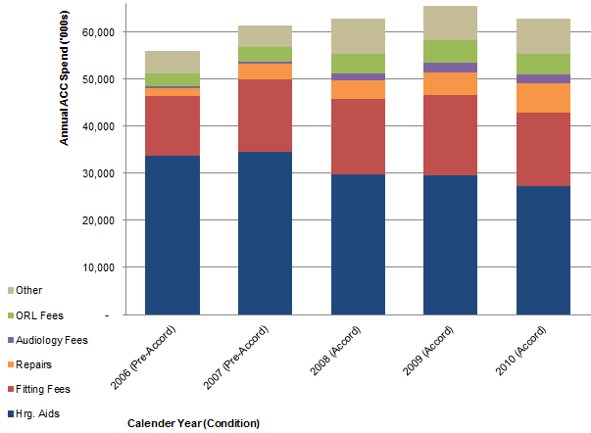
How things looked pre-regulations Annual spend on hearing loss by ACC
Notes:
Cost in core services (fitting) actually declined through the accord
Trends in repairs
Impact of Accord on hearing aid spend

Slide 9
ACC & ONIHL: 2011 & on Introduction of Regulations
Significant reduction in contribution by ACC to cost of hearing aids and professional audiological fees
Introduction of apportionment of cost of rehabilitation (ONIHL vs other forms of hearing loss)
ACC only liable for proportion of loss attributable to ONIHL
Determined by audiometric result, client age, ability of client to accurately recall & describe occupational noise history, & ORL evaluation (gatekeeper role?), no consideration of hearing need & impact of ONIHL
Proportional contribution from MOH, from a lower basis ($444 per aid)
Significant reduction in entitlements for ongoing maintenance
Increase in reaiding period to once every 6 years
Notes:
Regulations has had significant impact, effectively pushing more burden of rehab to claimant
Has fundamental inequities & impact has been bigger than projected in terms of dollars and access

Slide 10
ACC & ONIHL: 2011 & on What apportionment really means
% Hearing Loss |  |  |  | ACC & MOH Contribution
Total | ONIHL | Otherª Age, other pathology | %ONIHL | ACC | MOH
7.4%^{b} | 5.0% | 2.4% | 67.6% | $0 | $889
7.4%^{b} | 7.4% | 0.0% | 100.0% | $4,200 | $800
25.0%^{b} | 7.4% | 17.6% | 29.6% | $1,260 | $622
25.0%^{b} | 18.0% | 7.0% | 72.0% | $3,360 | $178
48.0%^{b} | 7.4% | 40.6% | 15.4% | $840 | $710
ª As diagnosed by ORL, based mainly on case history
^{b} Potentially require similar hearing aid technology (power does not carry a price premium)
Notes:
No linear relationship between severity of hearing loss (% hrg loss) & perceived handicap
Emphasis impact of backing out expected AVERAGE hearing loss due to age
No consideration of hearing need
Has 6% become the target?
Apportionment rationale not logical or fair and passes more burden to claimant. If recognise cost of treating ONIHL similar irrespective of actual % loss (i.e. cost based on needs) then MOH should contribute to ACCs costs according to their funding basis if want to share cost of rehab and have fair reflection of which agency should be making contribution.

Slide 11
ACC & ONIHL: 2011 & on Impact of regulations on demand for services
DATA NOT AVAILABLE
DATA NOT AVAILABLE
Notes:
Decline in acceptance rate for new claims (~65% to around 50%, shame to miss 2010 data) - ?6% or ENT practice
Emphasise decline in # of people proceeding with rehabilitation (lower than projected, 50% lower uptake of MOH share than projected)
Question why – main driver is probably liability for cost

Slide 12
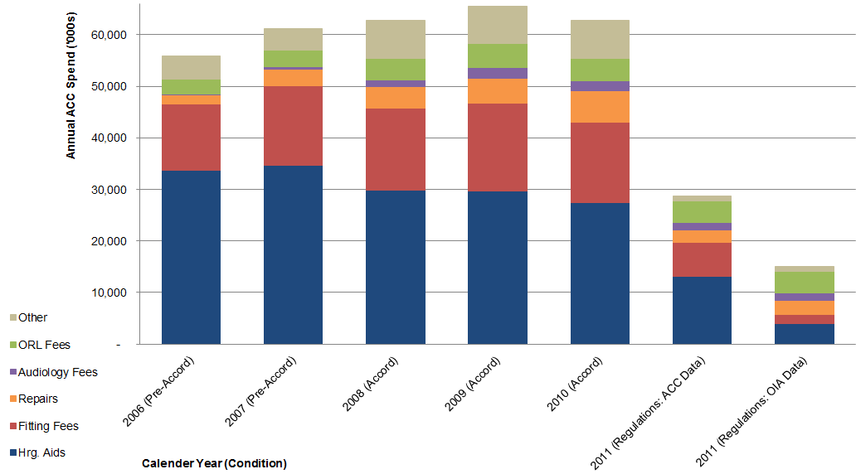
ACC & ONIHL: 2011 & on Annual spend on hearing loss by ACC
~47 mio/annum (-75%)
Notes:
Explain possible difference between ACC & OIA data
Emphasise reduction in spend on service (anecdotal evidence re not proceeding with repairs), & reduction of ~50% of service actions
ENT fees have stayed steady (not regulated)
Assumptions of OIA data

Slide 13
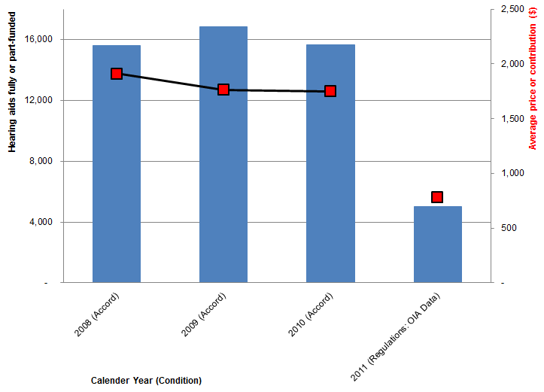
ACC & ONIHL: 2011 & on Uptake of hearing aids
Notes:
Highlight ASP pre Accord ($2300) and that post accord is calculated average contribution

Slide 14
ACC & ONIHL: Introduction of regulations Summary of impact
Uptake of hearing loss services has reduced significantly more than ACC predicted
It appears the introduction of regulations has seen an ~75% reduction in funding from ACC for ONIHL
Has created issues with affordability & access
Significant proportion of claimants with recognised cover and a need for hearing aids appear to not carry on with rehabilitation
For same diagnosed ONIHL, can have markedly different contribution from ACC if have differing degrees of idiopathic/age-related/other hearing loss, even though the same hearing aids may be appropriate
Notes:
On last point, highlight influence of ORL diagnosis. Since 6% threshold ACC have employed a practise of directing assessments to certain ORLs.

Slide 15
ACC & ONIHL: 2010 & on A final point: What is happening with the OCL?
Changes in last 5 years driven by OCL growth
Need to have future liability fully funded by 2019
Burgeoning 65+ age demographic
Actuarial assumptions?
ACC Report September 2012: Review of ACC Hearing Loss Regulations
Reduction of OCL of ~$675mio to $682mio
Cabinet advised in 2010 that regulations would reduce by ~$500mio
Still issues with models of future demand for ACC compensation for hearing loss?
Notes:
Make note that in no way have complete understanding of actuarial assumptions, but it seems to me that the baseline for future uptake of services is based on recent trend in regards to age of client at time of first access to ACC for hearing loss (~65 years). =>project that into the future with baby boomer impact get big increase in modelled demand and therefore cost. But appears to be no consideration of changes in the NZ workforce (reduction in industry and noise generating effects, increased awareness and more effective management of noise in workplace)

